Slide 1
A Note for those Stumbling on these Slides (Hi!)
These lecture slides are not intended as written reference materials.
Just reading them probably won’t be very educational.
Best used in combination with webcasts and source code references.
See (Video) and (Code) links under each lecture: http://datastructur.es

Slide 2

CS61B: 2018
Lecture 1:
Introduction
Course Logistics
Hello World

Slide 3
61B Overview
What is 61B about?
Writing code that runs efficiently.
Good algorithms.
Good data structures.
Writing code efficiently.
Designing, building, testing, and debugging large programs.
Use of programming tools.
git, IntelliJ, JUnit, and various command line tools.
Java (not the focus of the course!)
Assumes solid foundation in programming fundamentals, including:
Object oriented programming, recursion, lists, and trees.

Slide 4
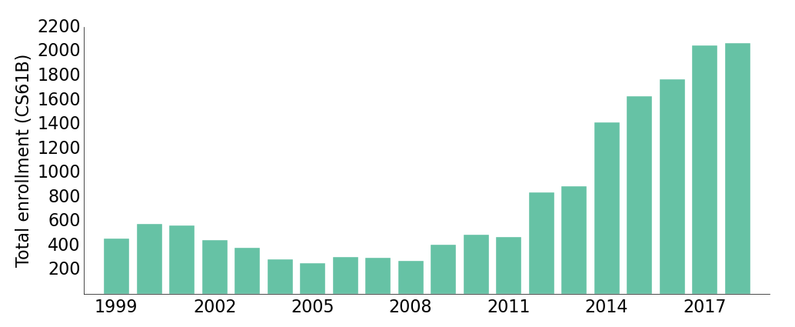
Why Study Algorithms or Data Structures?
Sp18

Slide 5
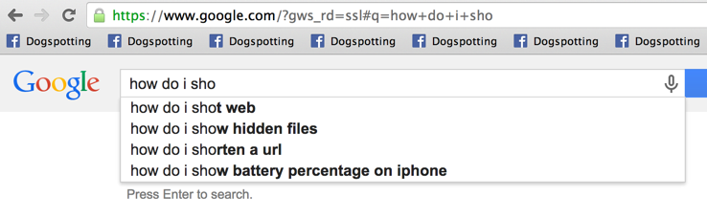
Why Study Algorithms or Data Structures?
Daily life is supported by them.

Slide 6
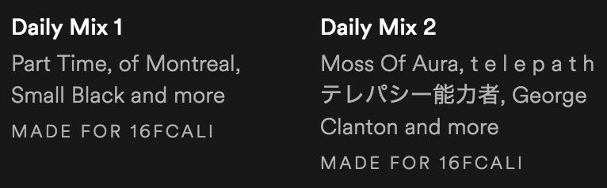

Why Study Algorithms or Data Structures?
Daily life is supported by them.

Slide 7
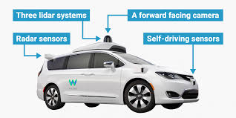
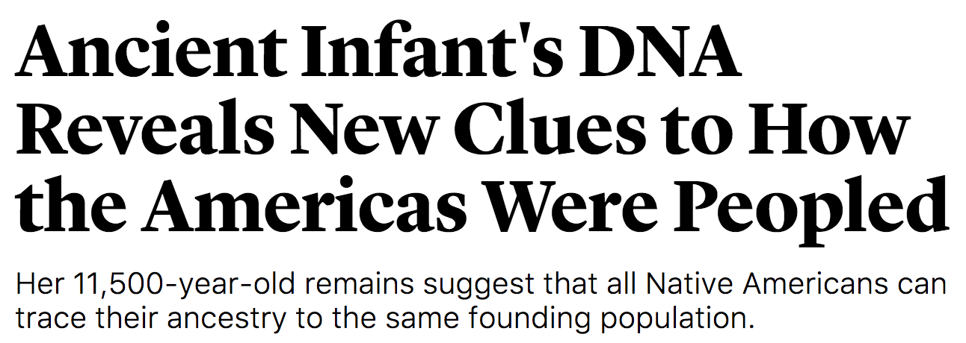

Why Study Algorithms or Data Structures?
Major driver of current progress (?) of our civilization (see CS195 for more).
Notes:
http://www.businessinsider.com/how-does-googles-waymo-self-driving-car-work-graphic-2017-1

Slide 8
Why Study Algorithms or Data Structures?
To become a better programmer.
“The difference between a bad programmer and a good one is whether [the programmer] considers code or data structures more important. Bad programmers worry about the code. Good programmers worry about data structures and their relationships.” - Linus Torvalds (Creator of Linux)

Slide 9
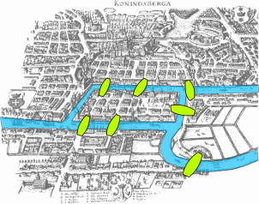


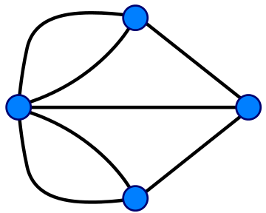
Why Study Algorithms or Data Structures?
For intellectual stimulation:
Possible to draw without picking up pencil or going back over any lines.
Impossible.
Notes:
http://members.ozemail.com.au/~macinnis/scifun/house.gif
Euler path: Must have exactly zero or two nodes of odd degree.

Slide 10

Why Study Algorithms or Data Structures?
To understand the universe. Science is increasingly about simulation and complex data analysis rather than simple observations and clean equations:

Slide 11


Why Study Algorithms or Data Structures?
To
create
beautiful
things.

Slide 12
Questions for You
What do you hope / expect to learn from this class? Why are you taking it?
Internship: Seems useful for getting internships.
Gain some sort of abilities that will allow us to make modifications to the world that are good for it.
Data structures
Entertainment: homeworks and projects.
Be a better programming: See gaining abilities.
Code well enough to change your gradescope grades.
Mysterious: through getting it right? Or scammmz

Slide 13
Who Are You?
Notes:
Freshman? Sophomore? Junior? Senior? Grad student? None of the above?
CS Major? Intending to be a CS Major? Something else?
61A? Java experience?

Slide 14
Who Are We?
Instructor: Josh Hug (me) hug@cs.berkeley.edu 779 Soda
GSIs (and a GSR):
Part time: Alex Kazorian, Alex Krentsel, Allen Guo, Annie Tang, Ashley Chien, Betty Chang, Catherine Han, Danny Chu, Dorian Chan, Gi-Gi Lu, Jackson Leisure, Jenny Huang, Jeremy Dong, Jiana Huang, Justin Mi, Karuna Wadhera, Kelly Lin, Matthew Owen, Matthew Sit, Michael Ju, Michelle Hwang, Sandy Zhang, Shubham Gupta, Vivian Fang
Full time: Albert Hu, Alex Hwang, Andy Zhang, Ashley Chen, Brandon Lee, Christine Zhou, Eli Lipsitz, JC Dy, Josh Zeitsoff, Kevin Arifin, Kevin Chang, Kevin Lin, Kevin Lowe, Nicole Rasquinha, Sam Zhou, Ting Ding, Wayne Li, Sarah Sterman, Jim Ren

Slide 15
Who Are We (continued)?
And 91 (at current count) academic interns: Kevin Ko, Boris Yue, Zoe Plaxco, Jingjing Jia, Alan Nguyen, Diana Tu, Samuel Shen, Angela Xiao, Nicolas Raga, Joshua Lin, Tanvee Desai, Stephen Zhou, Nico Camerino, Max Yuan, Moses Kim, Daniel Nguyen, Jasper Gan, Jennifer Xie, Jackie Li, Kevin Deguzman, Shayan Askarian Namaghi, Yu Chen, Janani Vijaykumar, Yiling Kao, Yowsean Li, Justin Lin, Jim Hollingworth, Zipeng Qin, Doreene Kang, Andre Andreassa, Jim Won, Katherine Liu, Min Jae Lee, Elizabeth Avelar Mercado, Natasha Wong, Harsha Nandiwada, Jack Ji, Seung Jin Yang, Yifan Ning, Adel Setoodehnia, Adi Zimmerman, Gabrielle Delforge, Anastasia Vela, Amy Mendelsohn, Shawn Yang, Yuan Gao, Emily Hill, Emily Lan, Rishab Kedia, Daniel Lin, Candace Chiang, Yihui Zhu, Saurav Chhatrapati, Jason Ma, Vibha Seshadri, Robert Chen, Kaan Dogusoy, Rena Chen, Emma D'Esopo, Daniel Li, Nasim Binnur , Brian DeLeonardis, Vera Wang, Camille Harris, Suren Gunturu, Benny, Julianna White, Duy Nguyen, Xu-Bin Kuang, Qian Pan, Lawrence Chen, Aura Barrera, Shruthi Chockkalingam, Auni Bagchi, Tina Zhao, Kevin Chien, Austin Cheng, Kyle Schweizer, Tony Liu, Fabiola Lopez, Kieran Davis, Brian Liao, Michelle Lee, Alex Yi, Jessica Gao, Andrew Raguse, Sai Mandava, Stella Wang, Sydney Yang, Robert Iancu, George Zeng
As well as 16 tutors, TBD.

Slide 16
Learning Philosophy

Slide 17
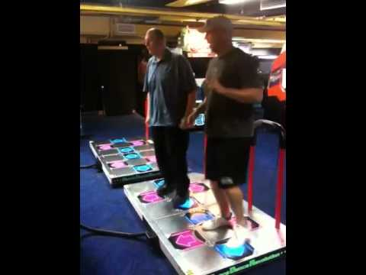

The Manner in Which Learning Occurs (TMWLO)
Notes:
12 minutes to reach this point (16 with new stuff)

Slide 18
TMWLO: A Small Minority
Lectures
Introduction to new material.
Reading
More thorough introduction.

Slide 19
TMWLO: The Vast Majority
Discussion Section, Vitamins, and Study Guides:
Practice with concepts and Java syntax.
Labs, Weekly(ish) Homework, and Your Own Experimentation
Practice with tools, programming techniques, Java syntax, and algorithms and data structures.
Projects
Similar to labs and HW, but larger and include a design component.

Slide 20
Course Logistics (Condensed)
See Slides at End / Online Video for the Full Version

Slide 21
Places to Get Information
Official Course Resources
Course website: http://datastructur.es
Lectures (or webcasts).
Piazza: http://piazza.com/class/61b
Office hours (locations and times TBA).
Lab (ok to discuss anything, even topics unrelated to that day’s lab).
Discussion.
Homework Parties.
5 student Group Tutoring Sections.
Mini-Textbook: Working title is just Hug61B for now: http://gitbook.com/book/joshhug/hug61b
Unofficial: Google, Stack Overflow, other programming courses on the web, various online documentation, etc.

Slide 22
Logistical Details
For waitlisted (or got removed from the class) folks: If you do project 0, I’ll do what I can to get you in by week 4.
If possible, go to your assigned section and lab this week.
If you don’t have one yet, go to any section or lab.
If room is too full, priority goes to those officially registered.
Not registered? Please wait outside until 2 minutes before start (XX:08).
Once attendance settles, doesn’t matter which lab/section/lecture you’re registered for.
Please post administrative issues to Piazza or send an email to cs61b@berkeley.edu
Please don’t email me directly (sorry!).
1400 students * 1 minute/student = 24.2 hours.

Slide 23
61B 2.5 - Course Structure
Phase 1: Programming Intensive Introduction to Java.
Weeks 1-4.
One browser-based programming HW (this HW0 is optional).
Three labs to introduce you to various tools (starting this week).
Two projects (proj0 and proj1).
Phase 2: Advanced Programming
Weeks 5-7.
One small HW (HW1).
One large project, due ~3/5.
New: You design your own explorable world (within some constraints).
Labs to support large project.

Slide 24
61B 2.5 - Course Structure
Phase 3: Data Structures and Algorithms
Weeks 8-14
Incredibly important and foundational material: Expect an CS job interview to lean heavily on this part of the course.
Labs: Implement a data structure or algorithm.
Each lab ends with a TA led discussion of best implementation.
Six HWs: Apply a data structure or algorithm toward a real world problem.
Two released during RRR week. Can be used to makeup missed homeworks earlier, or for practice.
One very challenging data structure/algorithms project (but not as big as project 2).
See calendar at http://datastructur.es for more.

Slide 25
Labs and Discussion
Attendance for lab/discussion is not required, but can earn “gold points” (extra credit) by attending discussion.
Labs:
Lab always due by Friday at 11:59 PM. Full credit for ‘reasonable effort’.
Lowest two of 14 labs dropped. No extensions or grace hours except emergencies that make you miss > 2 labs.

Slide 26
HWs and Projects
5 standard homeworks and 2 makeup homeworks.
Lowest 2 of 7 dropped.
Due dates vary widely, see calendar.
No extensions or grace hours except emergencies that make you miss > 2 labs.
Projects:
Projects 1 and 3 must be done solo. 0 and 2 can be done as a pair.
Projects 2 and 3 will be really time consuming and difficult.
All code on solo projects must be your own work.
Ok to discuss with others and help debug.
Extra credit opportunities on projects 1, 2, and 3.
Point deduction per hour late.

Slide 27
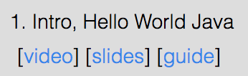
Vitamins and Study Guides (for conceptual understanding)
Short lecture exercises, a.k.a vitamins.
Due on Sunday at 11:59 PM.
Lowest 2 of 14 are dropped.
Study guides for each lecture.
Provides a brief summary of the lecture.
Provides (usually) C level, B level, and A level problems for exam studying.
A level problems are usually hard enough that I anticipate TAs will have a hard time with them, so be nice!

Slide 28
Exams
Closed note except you can bring cheat sheets.
Will be pretty hard (60% medians).
Showing improvement on final can boost overall exam score.
Exam dates (midterms tentative until room deadlines confirmed):
Midterm 1: February 12th, 8:00 -10:00 PM (drop deadline is February 16th)
Midterm 2: March 20th, 8:00 - 10:00 PM.
May 9th (final exam) at 7 PM.
There will be no alternate exams (see exam replacement policy).

Slide 29
Course Grade
Breakdown: 1,584 points total. Letter grade will be determined by your total.
Midterms: 400 points total.
Final: 400 points.
Projects: 480 regular points.
HW: 160 points (32 points each)
Lab: 96 points (8 points each)
Vitamins: 48 points (4 points each)
Grades are not curved, i.e. they are not based on your relative performance. In past semesters, grade bin cutoffs have not budged (or if they did, just barely).
See http://sp18.datastructur.es/about.html for full details including grading bin cutoffs.
Plus occasional opportunities for extra credit for filling out course feedback surveys and projects 1, 2, and 3.
Notes:
26 minutes

Slide 30
Course Pacing
We will start off very fast.
Optional HW0 is out.
Intro to Java syntax.
Will take 1-4 hours.
Work with friends!
Recommended that you complete before your lab.
Strongly recommended that you complete by lecture Friday.
Lab1 and Lab1 Setup are both available.
Lab1: How to use various tools.
Lab1 Setup: How to set up your home computer (maybe do before lab1).
Project 0 released Friday. Due next Friday Jan 26th (10 days from start of semester).
Exercises all the basic Java features.
Allowed to work in pairs (more next time).

Slide 31
Hello World
(See guide for link to the code I write today)
(Might be a little boring if you know Java already)

Slide 32
Java and Object Orientation
Java is an object oriented language with strict requirements:
Every Java file must contain a class declaration*.
All code lives inside a class*, even helper functions, global constants, etc.
To run a Java program, you typically define a main method using public static void main(String[] args)
*: This is not completely true, e.g. we can also declare “interfaces” in .Java files that may contain code. We’ll cover these later.

Slide 33
Java and Static Typing
Java is statically typed!
All variables, parameters, and methods must have a declared type.
That type can never change.
Expressions also have a type, e.g. “larger(5, 10) + 3” has type int.
The compiler checks that all the types in your program are compatible before the program ever runs!
e.g. String x = larger(5, 10) + 3 will fail to compile.
This is unlike a language like Python, where type checks are performed DURING execution.

Slide 34
Reflections on Static Typing
The Good:
Debugging is a lot easier, type errors are avoided.
Produciton code has no type errors, so that means people’s phones won’t crash because of type errors.
Programs run more efficiently in time and memory.
Self-documenting: YOU KNOW WHAT YOU’VE GOT.
The Bad:
Code is more verbose.
Code is less general.

Slide 35
What’s Next
This week:
HW0: Out now. Will give you a chance to explore Java basics on your own.
Lab1: How to compile and run code on the lab machines. How to check out homework starter files and submit them. If possible, do HW0 before lab!
Lab1 Setup (optional): How to compile and run code on your own machine.
Project 0 coming soon (out by Friday, maybe sooner). Only two types of partnerships allowed:
Both partners have taken a Java class.
Neither partner has taken a Java class.
No mixed groups.
Next lecture: What all that public static blah blah stuff actually means.

Slide 36
Course Logistics (Full Version)

Slide 37
Places to Get Information
Official Course Resources
Course website: http://datastructur.es
Lectures (or webcasts).
Piazza: http://piazza.com/class/61b
Office hours (locations and times TBA).
Lab (ok to discuss anything, even topics unrelated to that day’s lab).
Discussion.
Homework Parties.
5 student Group Tutoring Sections.
Mini-Textbook: Working title is just Hug61B for now: http://gitbook.com/book/joshhug/hug61b
Unofficial: Google, Stack Overflow, other programming courses on the web, various online documentation, etc.

Slide 38
Logistical Details
For waitlisted folks: If you do project 0, I’ll do what I can to get you in by week 4.
If possible, go to your assigned section and lab this week.
If you don’t have one yet, go to any section or lab.
If room is too full, priority goes to those officially registered.
Not registered? Please wait outside until 2 minutes before start (XX:08).
Once attendance settles, doesn’t matter which lab/section/lecture you’re registered for.
Please post administrative issues to Piazza or send an email to cs61b@berkeley.edu
Please don’t email me directly (sorry!).
1400 students * 1 minute/student = 24.2 hours.

Slide 39
61B 2.5 - Course Structure
Phase 1: Programming Intensive Introduction to Java.
Weeks 1-4.
One browser-based programming HW (this HW0 is optional).
Three labs to introduce you to various tools (starting this week).
Two projects (proj0 and proj1).
Phase 2: Advanced Programming
Weeks 5-7.
One small HW (HW1).
One large project, due ~3/5.
New: You design your own explorable world (within some constraints).
Labs to support large project.

Slide 40
61B 2.5 - Course Structure
Phase 3: Data Structures and Algorithms
Weeks 8-14
Incredibly important and foundational material: Expect an CS job interview to lean heavily on this part of the course.
Labs: Implement a data structure or algorithm.
Each lab ends with a TA led discussion of best implementation.
Six HWs: Apply a data structure or algorithm toward a real world problem.
Two released during RRR week. Can be used to makeup missed homeworks earlier, or for practice.
One very challenging data structure/algorithms project (but not as big as project 2).
See calendar at http://datastructur.es for more.

Slide 41
Lab Logistics
OK to work on labs ahead of time.
Attendance not required, except for special project labs (more later).
Lab always due by Friday at 11:59 PM.
Full credit for ‘reasonable effort’.
Some labs are freebies (automatic credit, even if you don’t show up).
14 total labs, worth 8 points each [96 points total].
Lowest two are dropped. Intended to cover life difficulties.
No extensions or grace hours except emergencies that make you miss > 2 labs.

Slide 42
Discussion Logistics
Attendance not required, but 2 gold points per discussion you attend (up to a maximum of 20 gold points).
Attendance not officially taken the first two weeks.
What’s a gold point?
Helps boost your score if you don’t do as well as on exams.
The lower your exam score, the more gold points help.
Up to a maximum of counting double if you get a zero on all exams.
Not a good strategy to intentionally get zero points on all exams.
See course info for the full details.

Slide 43
HWs
Homework breakdown:
HW0: Optional browser based Java exercises.
HW1: Practice with advanced Java features.
HW2-7: Applications of various data structures and algorithms.
Due dates vary. See calendar.
7 total required homeworks, worth 32 points each [160 points total].
Lowest two are dropped. Intended to cover life difficulties.
No extensions or grace hours except emergencies that make you miss > 2 labs.

Slide 44
Vitamins and Study Guides (for conceptual understanding)
Each week, there will be a series of exercises (vitamins) for that week’s lectures.
Due on Sunday at 11:59 PM.
Relatively short.
Primarily intended to keep you on track with lectures.
4 points each for 48 points (lowest two of 14 are dropped).
For each lecture, there is also a “study guide”.
Provides a brief summary of the lecture.
Provides (usually) C level, B level, and A level problems for exam studying.
A level problems are usually hard enough that I anticipate TAs will have a hard time with them, so be nice!

Slide 45
Projects
Four projects
One lightweight project, two medium projects, one large project.
Project 0 (solo or pair): 50 points
Project 1 (solo): 80 points
Project 2 (pair): 200 points
Project 3 (solo): 150 points
Projects 2 and 3 will be very time consuming. Plan ahead.
All code on solo projects must be your own work.
Ok to discuss with others and help debug.
Projects 1, 2, and 3 will have extra credit opportunities.
Early submission deadline: Bonus points.
Stretch goals: “Gold” points.

Slide 46
Exams
Exams will be “hard”
Median scores will be lower than you might be used to (ideally ~60%).
Two midterms in evenings, one final exam.
One sheet of paper (front and back) per exam.
If your midterm grades are statistically much worse than your final, we’ll replace your midterm grade. See “supersession” on course info page for the full details.
Exam dates (midterms tentative until room deadlines confirmed):
Midterm 1: February 12th, 8:00 -10:00 PM (drop deadline is February 16th)
Midterm 2: March 20th, 8:00 - 10:00 PM.
May 9th (final exam) at 7 PM.
There will be no alternate exams (see exam replacement policy).

Slide 47
Course Grade
Breakdown: 1,584 points total.
Midterms: 400 points total.
Final: 400 points.
Projects: 480 regular points.
HW: 160 points (32 points each)
Lab: 96 points (8 points each)
Vitamins: 48 points (4 points each)
Grades are not curved, i.e. they are not based on your relative performance. In past semesters, grade bin cutoffs have not budged (or if they did, just barely).
See http://sp18.datastructur.es/about.html for full details including grading bin cutoffs.
Plus occasional opportunities for extra credit for filling out course feedback surveys and projects 1, 2, and 3.
Notes:
26 minutes

Slide 48
Course Pacing
We will start off very fast.
Optional HW0 is out.
Intro to Java syntax.
Will take 1-4 hours.
Work with friends!
Recommended that you complete before your lab.
Strongly recommended that you complete by lecture Friday.
Lab1 and Lab1 Setup are both available.
Lab1: How to use various tools.
Lab1 Setup: How to set up your home computer (maybe do before lab1).
Project 0 released Friday. Due next Friday Jan 26th (10 days from start of semester).
Exercises all the basic Java features.
Allowed to work in pairs (more next time).

Slide 49
Citations
Real-time MRI by the New Scientist: https://www.youtube.com/watch?v=8XQlIvlWqpo
Self-driving car image by The Guardian: http://www.theguardian.com/technology/2014/may/28/google-self-driving-car-how-does-it-work
Dance Dance Revolution videos from:
https://www.youtube.com/watch?v=OVtnnIifaU8
https://www.youtube.com/watch?v=12lSScKSx20

Slide 50
Questions for You [first lecture]
What do you hope / expect to learn from this class? Why are you taking it?
Learn how to organize code to make my life easier.
Get a job with it.
Civlization seems to have gone weird in the west, and if I want to bein hte middle class or higher, being able to program certainly seems useful. Let’s do that. Required for degree.
Need it for major: EECS.
Better understanding of efficiency.
Learn how to build large projects.
Subscribe to my spotify list. To undersatnd the algorithm behind it… this class might be marginally helpful.
Because you can get a job, and then work at Spotify and then learn how it works.

